Slide 1
Intro
Electricity
Analog / digital circuits
Various sensors
Controlling a high amperage load through a transistor
Serial communication
What next? (more sensors, serial communication, visualizing input, wireless, controlling AC loads?...)
Notes:
Tell them who I am
Figure out what it is they want to learn and where they are at
Tell them what I have prepared
Learn or just make

Slide 2
Electricity
Electricity: flow of electrons through a conductive material
Current (Amps): measure of how many electrons are flowing
Voltage (volts): the electrical energy (analogy: pressure)
Resistance (Ohms): a material’s ability to RESIST or oppose current
ANALOGY: water flowing through a hose:
current = HOW MUCH
Voltage = PRESSURE
Resistance = SIZE of the hose

Slide 3
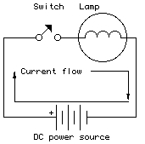
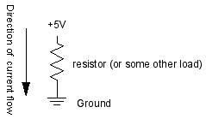
V=IR
A circuit: a closed loop containing a source of electrical energy (battery) and a load (a light bulb, a motor, etc.)
Voltage = resistance * amperage
Current follows the path of least resistance
A simple circuit

Slide 4
Let’s get started
Notes:
I can probably skip this

Slide 5
LED blink

Slide 6
Uploading a sketch

Slide 7
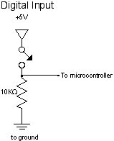
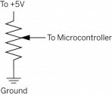
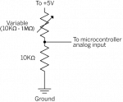
Review
Analog vs. Digital
Digital inputs have two states: off and on. If voltage is flowing, the circuit is on. If it’s not flowing, the circuit is off.
When we want to measure variably changing conditions like this, we need analog inputs.
Examples: thermistors, photocells, force sensing resistors, flex sensors, …

Slide 8
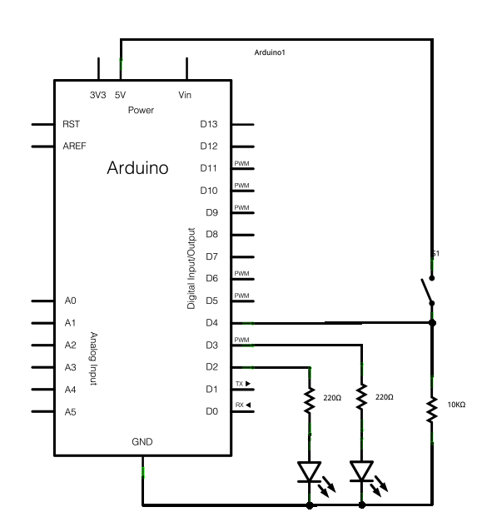
A digital circuit
Here's a circuit for a program that reads the digital input on pin 4.
Then it turns on the LED on pin 2 if the input is high (i.e. the switch is on), or turns on the LED on pin 3 is the input is low (the switch is off):
Notes:
digitalSwitch.pde

Slide 9
The switch code

Slide 10
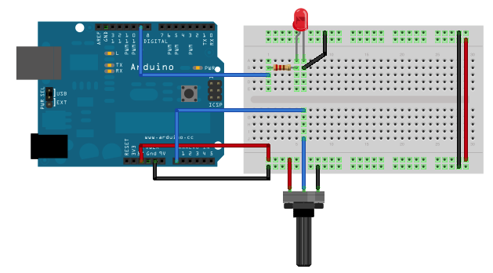
An analog circuit
When you run this code, the LED should dim up and down as you turn the pot, and the value of the pot should show up in the debugger pane.
Notes:
analogInput

Slide 11
Analog input code

Slide 12
Another sensor, and the map() function
Let’s replace the potentiometer with a photocell (or any variable resistor)
Add a fixed resistor? (voltage divider)
Look at the serial monitor: find out the RANGE of the analog sensor - note the maximum and minimum values
Before, a potentiometer was giving us analog input values of 0 – 1023, the full range of the analogRead() function;
Now, we must modify the code using the map() function
Map the input (min – max sensor reading) to the output (0-255 – because 0 – 255 is the range of Arduino’s analogWrite() function
Map the incoming values:
Notes:
analogInput_mapped.pde
Connected from a0→photocell→power and to ground through the 1K resistor
Voltage divider circuit – fixed resitstor should have the same order of mag as the variable resistor’s rance
Potentiometer gives 0-1023, full range of analog Input; divide by 4 gives you range 0-255, full output range of the analogWrite() command;
Voltage divider circuit CANT give you the full range. Fixed resistor in the circuit limits the range. So you must modify the code - find out the range by openingthe serial monitor. Note the max and min values. Then map the range

Slide 13
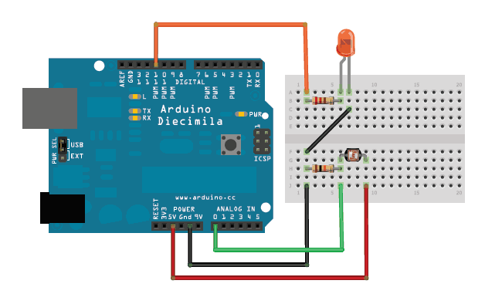
Photocell circuit

Slide 14
Code for one photocell and one LED
NOTE: you may have to modify the map() function, depending on your sensor

Slide 15
Excersize
Use the map() function to make the LED get less bright as the photocell gets darker, and brighter with MORE light…

Slide 16
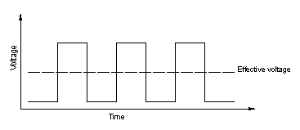
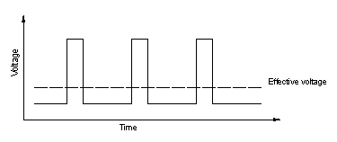
Analog Output: Pulse Width Modulation (PWM)
Most microcontrollers “fake” an analog voltage output by producing a series of voltage pulses at regular intervals, and varying the width of the pulses (PWM)
DUTY CYCLE = ratio of the time the pin is HIGH to the time it is LOW
Here the duty cycle is 50%, making the voltage output about half
The duty cycle is less because it is OFF for longer

Slide 17
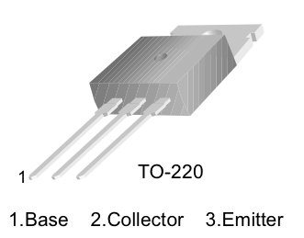
Powering a high-current load using a transistor
An electronic switch

Slide 18
Transistor circuit code

Slide 19
Controlling AC current
The RELAY: A mechanical switch
- slow response, so unlike a transistor, we cannot control the output voltage (in the past example, the transistor was opening and closing rapidly and the motor was getting slower)
- use a small (5V) input from arduino to allow AC current to flow through,
thereby turning on an AC load using Arduino

Slide 20
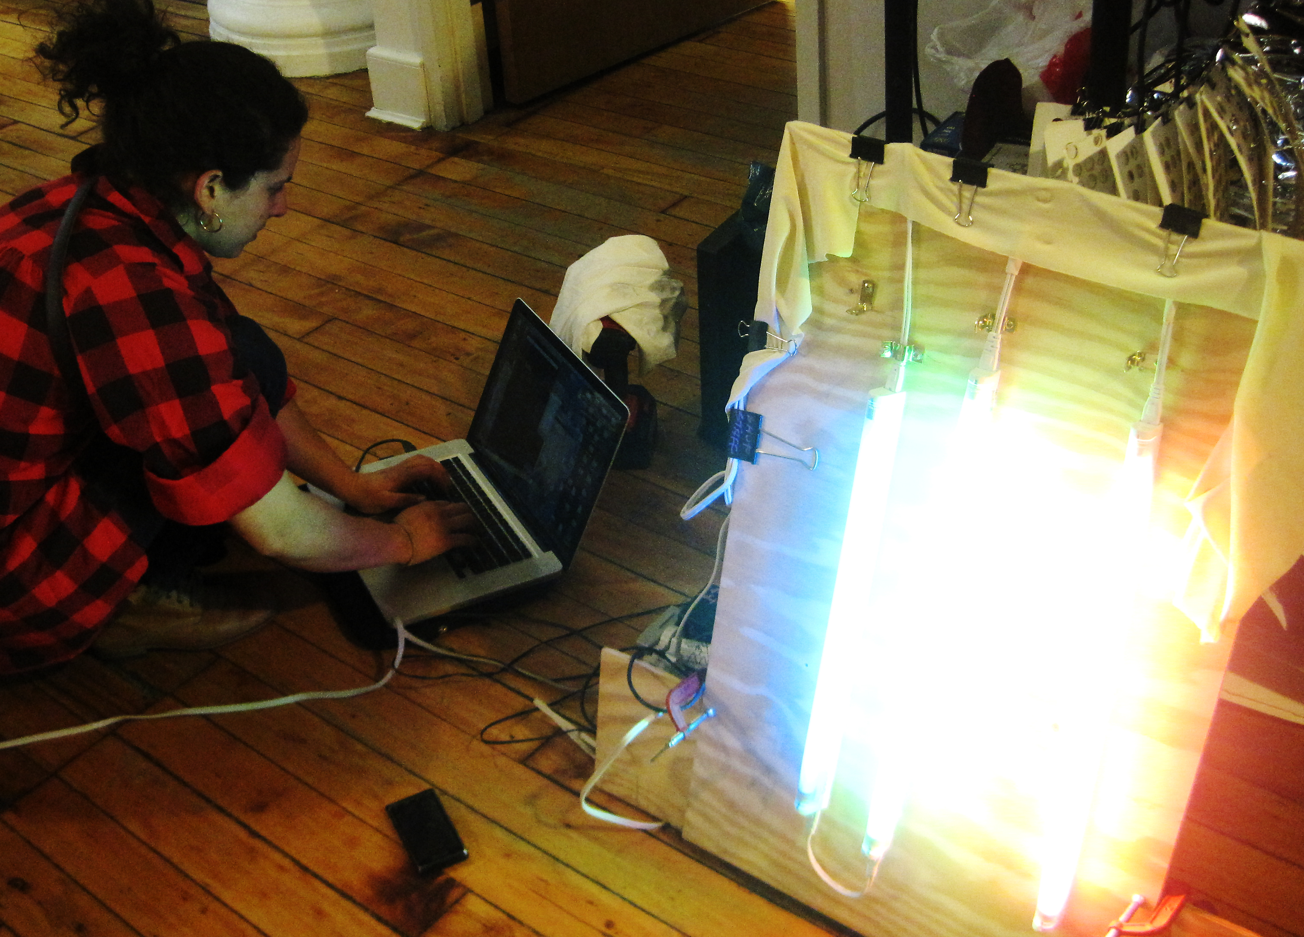
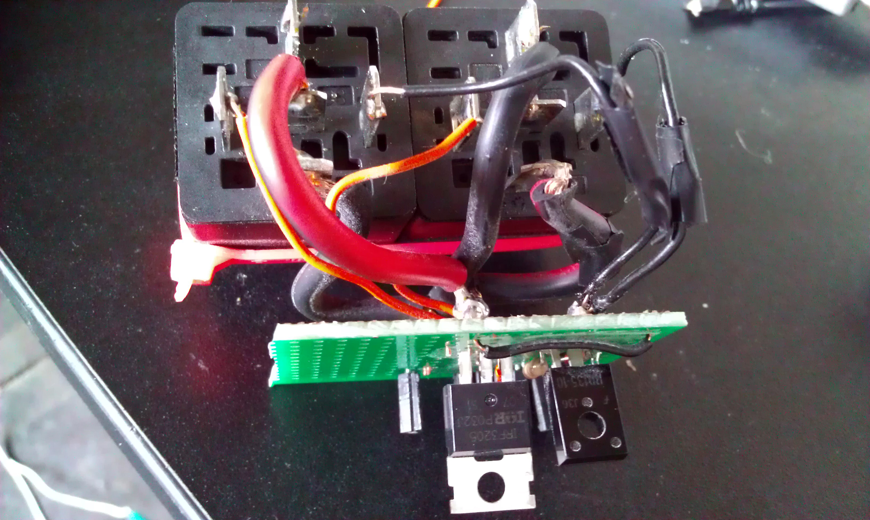
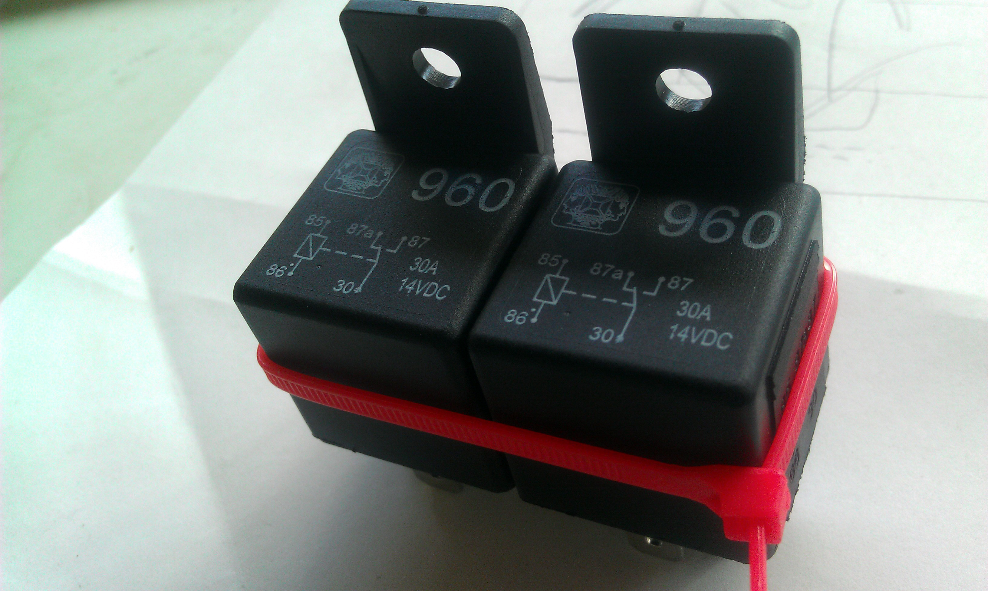
Two 12V relays used to
reverse the direction of
A motor (a motor driver
does this, however)
For an RC sailboat using
Two motors from a drill
A relay used to switch on AC current to turn on fluorescent lights

Slide 21
Visualizing the data
Sometimes it’s nice to see sensor data in a graph
-CoolTerm (a serial port terminal application)
-Processing (an open-source programming language to create images, animations, interactions…)
We’ll use CoolTerm for now:
http://www.macupdate.com/app/mac/31352/coolterm
Download and open CoolTerm.
Notes:
Do they know how to program – do they want to use processing?
We don’t have to do this – we can do more with Arduino, look at relays…

Slide 22
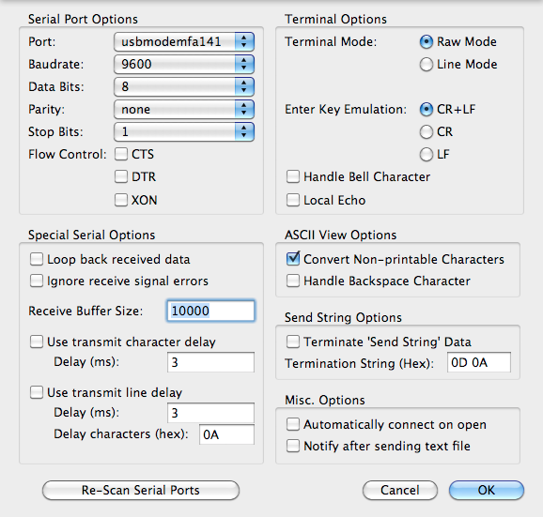
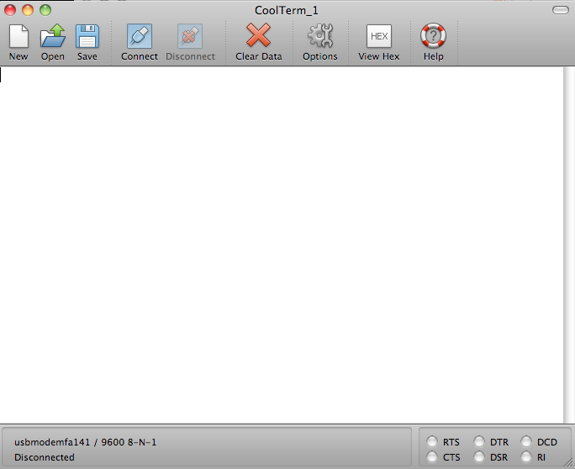
CoolTerm
Let’s go back to a sketch that reads sensor information (such as the one with the photocell) and prints it to the serial port
With your arduino connected:
Click Options
Make sure the Baudrate is set to 9600 (remember, in Arduino we set it to 9600 using Serial.begin(9600)
NOTE: you cannot have two ports open at the same time
(so you can’t view the Arduino’s serial monitor while you are using CoolTerm

Slide 23
Start recording
Now click CONNECT
Click Connection → Capture to TextFile
→ Start
You should see data scrolling through
You can specify where to save the text file

Slide 24
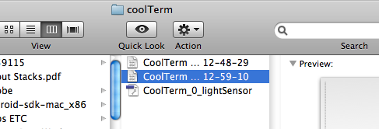
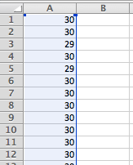
Graph the data
Open the file with excel:
Your data should look something like this:
a long column of numbers (your sensor data)

Slide 25
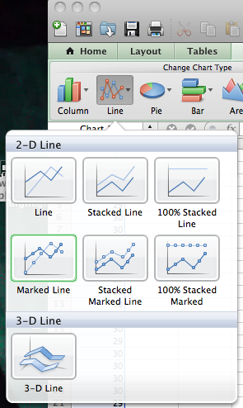
Graph the data
-Click on “Chart”
-Then click on “Line”
Then click on “Line”

Slide 26
And you should get something that looks like this:
(This is from me moving
My hand near and far
The photocell)
Now you can work in excel to label the axes and format it how you like

Slide 27
Serial communication
You’ve already used this via Arduino’s serial monitor
Computer → Arduino, agree upon rate (9600 baud)
Sending a series of digital pulses back and forth (via a transmit wire and a receive wire)
By interpreting several bits of data over time, the receiver can get a detailed message from the sender
More complicated sensors: MIDI, GPS, accelerometer
Digital pins 0 and 1 on Arduino are for transmitting and receiving data

Slide 28
What we did today
Reviewed the basics of electricity
Reviewed analog vs. digital input
Made circuits that use analog and digital input
Made a circuit that uses analog output (PWM)
Controlled high-amperage loads using a transistor
Visualized the data using CoolTerm

